Slide 1


An Ensemble Method for Traffic Light Management
Presenter: Evangelos Mathioudis
School: University of Nicosia
Program Title: MSc in Data Science
Supervisor: Ioannis Katakis
Notes:
Welcome, everyone to the thesis defense on an ensemble method for traffic light management.
My name is Vangelis Mathioudis and I am a student of the master of science in data science at the University of Nicosia. I am also working as a junior researcher for the AI Lab of the University of Nicosia, running my STEM academy at Chios island, and I am a father of three
Before we start I would like to thank you all for attending
From the very first time I heard of reinforcement learning, I was excited about the field’s potential and its possible applications.
Together with NLP and Computer vision applications, applications of RL were a topic that I always wanted to get involved in it.
The idea of applying RL on traffic signal control came soon after traffic signals were installed on Chios roads and I noticed how much time we lose waiting at red traffic lights while the road is empty.
With my supervisor Dr. Katakis we decided to start research on ensemble methods for traffic light management as it is something that hasn’t been used till now in traffic signal control.

Slide 2
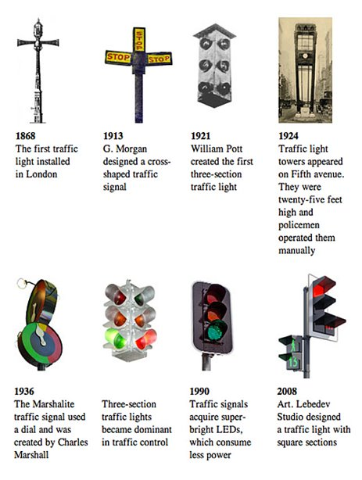
Background Traffic Signal Control
History
Inefficiencies of Traffic Signals Lead to:
Costs Up to 1% of EU's GDP
Increase Harmful Emissions - contributes to 23% of total CO2 emission from fuel combustion
Notes:
A bit of history on traffic signals.
The first traffic signal was installed in London in 1868. The structure of the traffic lights remains almost the same since 1921.
Traffic signals impact virtually everyone every day.
Pedestrians and drivers act according to them. Drivers confidently place their own and their passengers' physical safety in a signal's allocation of right-of-way.
People accept and in some cases demand traffic signals to assure safety and mobility. Drivers usually assume that the responsible agency can efficiently operate signals, so motorists usually report only the most obvious failures. However, inefficiencies silently steal dollars from the public in increased fuel costs and longer trip times. Users normally perceive signals as working if they turn red and green. But what about if they don't work efficiently?
Studies have shown that Traffic congestion costs in the EU are estimated to be 1\% of the EU’s Gross domestic product and also the transport sector contributes to 23% of total carbon dioxide emission.

Slide 3

Background Traffic Signal Control
Objective
Safe and efficient movement of vehicles at intersections
Considerations:
Yellow time,
Left turn phase (interval),
Minimum green phase (interval)
Measures:
Travel time,
Queue length,
Number of stops,
Delay
Notes:
Traffic signal control systems are used to ensure safe and efficient movement at intersections.
Depending on the road network and the intersection scale we might need to think of the yellow phase time, the interval for left turns in case they are permitted, and the minimum green phase duration.
We evaluate the efficiency of a traffic signal by measuring the number of stops, the queue length of stopped vehicles and the travel time in the case we have multiple traffic signals.

Slide 4

BACKGROUND
HOW DO WE HANDLE TRAFFIC SIGNAL CONTROL?
Most common methods:
Fixed-time control,
Actuated control,
Adaptive control
Fixed-time Control
Fixed-time traffic signal cycles
Cons
Doesn’t adapt to traffic demand
Fixed-time settings:
Pre-timed cycle length ,
Fixed cycle-based phase sequence,
Phase split
Notes:
So, in what ways do we handle traffic light management today?
Conventional traffic signal control methods are fixed-time, actuated, and adaptive control.
In small regions or on single intersections the most common control is the fixed-time.
As the name declares in fixed-time control the timing plans are set with fixed-time traffic signal cycles without adjustment to the traffic demand. Common practices to configure fixed-time settings are pre-timed cycle length, fixed cycle-based phase sequence, and phase split.
Fixed-time control can not adapt to traffic changes and this makes it significant inefficient.

Slide 5
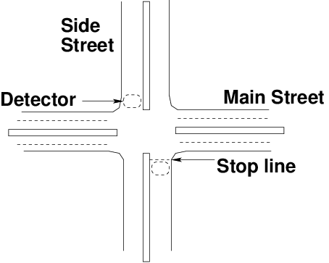
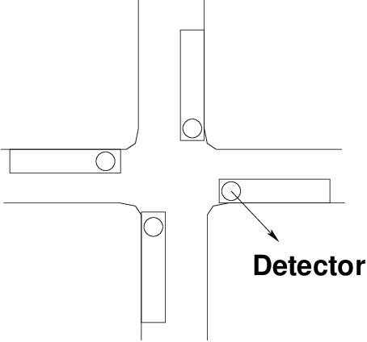
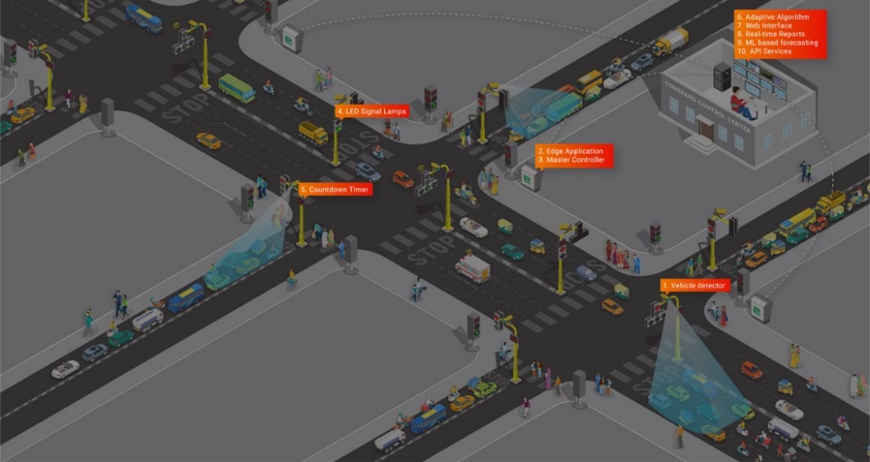
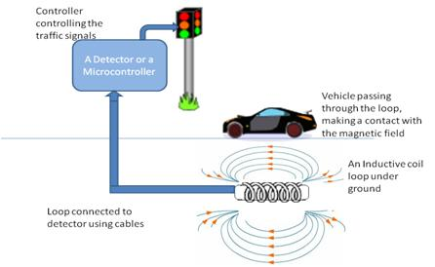
BACKGROUND
HOW DO WE HANDLE TRAFFIC SIGNAL CONTROL?
Semi-actuated
Full-actuated
Actuated Control
Semi-Actuated,
Full-Actuated,
Volume Density,
Cons:
Prioritize movement along the primary road,
Maintenance requirements
Adaptive Control
Adaptive Traffic Control Systems (ATCS),
Real time phase manipulation,
Cons:
Small area of detection,
Data don’t represent real traffic volume
Vehicle Actuated Signals - Lecture Notes in Transportation Systems Engineering
Prof. Tom V. Mathew
Notes:
Actuated control uses sensors to determine which phase will activate.
We meet three forms of actuated control:
Semi-Actuated is when the sensors are only in the direction of the side streets. The side streets default to red and only turn green when a vehicle is detected by the sensor.
Full-Actuated is when all directions have sensors. The traffic signal controller makes decisions based on the data supplied by the sensors.
Volume-Density is similar to Full-Actuated, but it uses more information from the sensors to make its decision. For example, the traffic signal controller may choose to remain green until a variable minimum gap between vehicles is achieved
In general, actuated control systems are not preferable because of the maintenance requirements. Additionally a Disadvantage of this control is that:
it prioritizes movement along the primary road and can present obstacles to cross traffic and pedestrians if have been timed to prioritize vehicle movements only.
Adaptive Traffic Control Systems (ATCSs), also known as real-time traffic control systems, adjust, in real-time, signal timings based on the current traffic conditions, demand, and system capacity by using sensors such as inductive loops or cameras.
Even though this control adapts to traffic changes, A Disadvantage is that:
the detection area of sensors is limited and captures only vehicles pass through this area, thus the captured data often doesn’t depict accurately the real traffic volume.

Slide 6

Research question: How can we efficiently manage traffic signals?
Deep Reinforcement Learning
Notes:
So the question that arises is how can we manage efficiently the traffic lights on an intersection to reduce for example traffic congestion, harmful emissions and trip duration?
A potential solution is to apply deep reinforcement learning.
Now I am going to present briefly the necessary background on reinforcement learning and deep reinforcement learning.

Slide 7

What is reinforcement learning?
"Reinforcement learning is learning what to do —how to map situations to actions— so as to maximize a numerical reward signal. The learner is not told which actions to take, but instead must discover which actions yield the most reward by trying them.“ Sutton, R. S., & Barto, A. G. (2018). Reinforcement learning: An introduction. MIT press.
Important concepts:
Environment
Agent
Rewards
States
Actions
Notes:
Reinforcement learning (RL) is learning through trial and error. As we see in the figure an agent learns to perform tasks by interacting with an environment. The agent will take an action $a_{t}$ based on the environment's current state $s_{t}$ and the environment will return to the agent a reward signal $r_{t+1}$ and change to the next state $s_{t+1}$. Through this process, the agent acquires knowledge to solve the environment by making the best decision at each time-step regarding the environment's state based on a policy that aims to maximize the agent's rewards.
A Policy is how the agent learns to make decisions on actions to be taken given a state. It defines the way the agent behaves within the environment. There are different types of policies e.g. a lookup table or a function. We could relate the agent's policy to the human's brain.
An environment can be anything we want to solve. For example it can be a simulation of the Atari game or in our case a simulation on SUMO software. The agent is an algorithm that makes observations and takes actions in the environment. Rewards are feedback the agent receives from the environment after taking an action. An action can be any possible move in our environment. For example in super mario game possible actions are:
- move straight
- move back or
- jump.
The set of possible actions called action space and the set of possible states called state space.
We often call a RL process as a Markov Decision Process because we assume that the agent needs only the current state to determine the next action and not the whole history of states and actions.
In the following slides I will go through a very popular algorithm in RL the Q-learning.

Slide 8
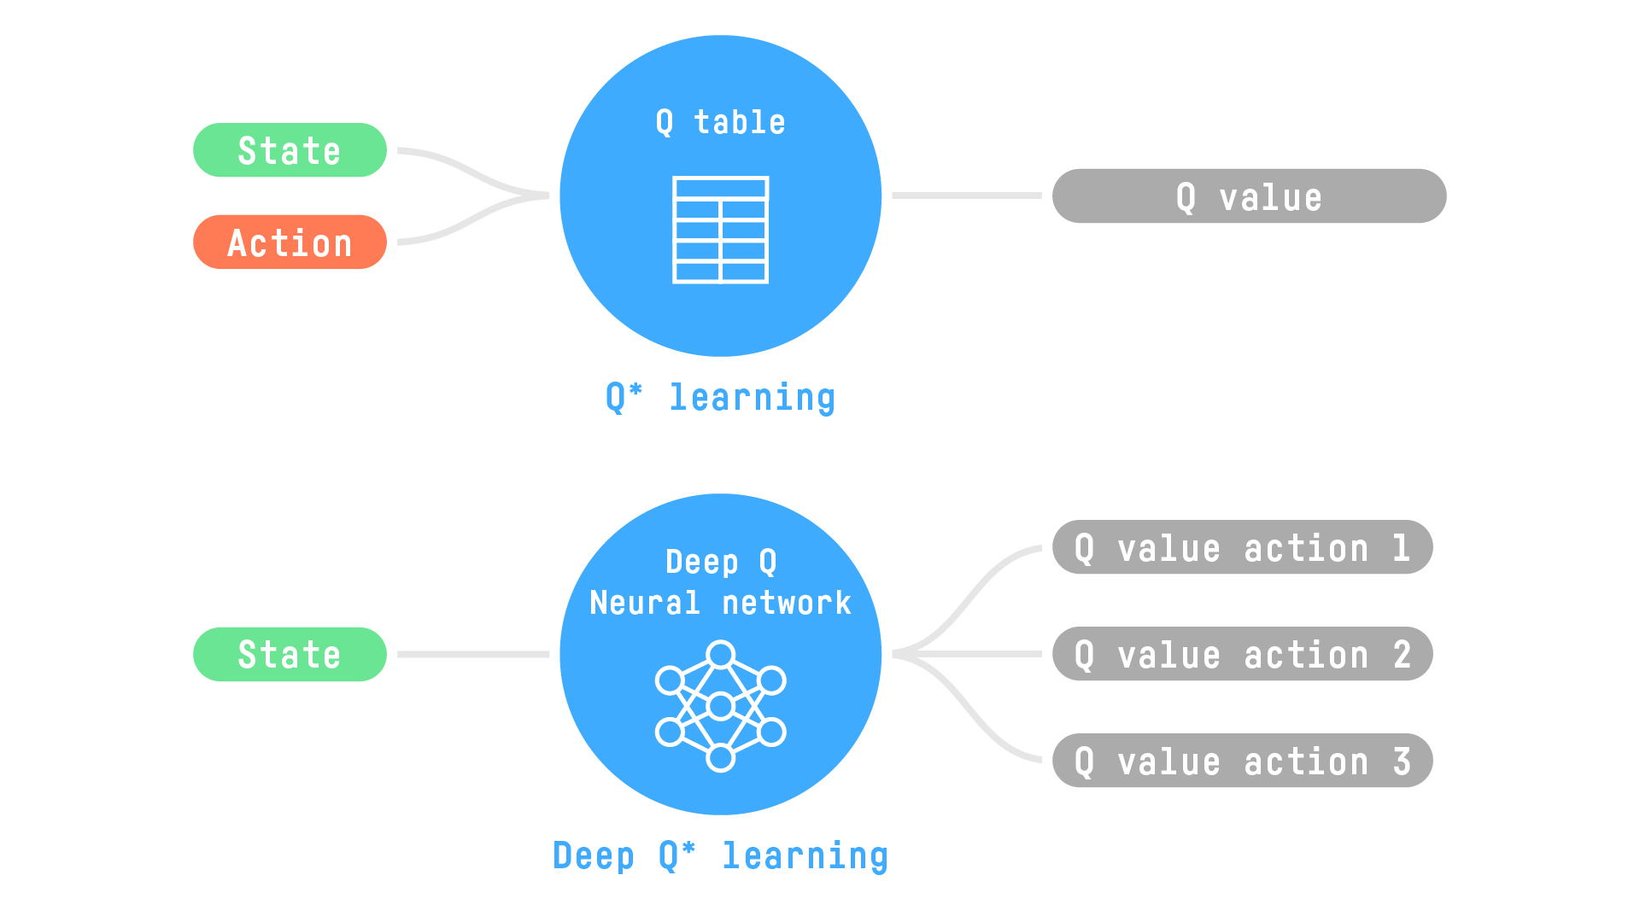
Q-learning
Q-Learning is:
Off-policy algorithm
Value-based method
Temporal Difference (TD) approach
Source: Dataiku Knowledge Base
Notes:
Q-Learning is an off-policy value-based method that uses a TD approach to train its action-value function.
Off-policy: using a different policy for acting and updating.
Value-based method: finds the optimal policy indirectly by training a value or action-value function that will tell us the value of each state or each state-action pair.
Uses a TD approach: updates its action-value function at each step instead of at the end of the episode.
As said before Policy is a function that maps a state or a state-action pair to a value also called quality value or for short q-value.
We can apply q-learning techniques on many cases but there are some limitations.

Slide 9
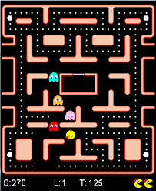
Downsides of classical reinforcement learning
Doesn't scale on large action space
Suffers from the curse of dimensionality on large state space
Notes:
the main problem with q-learning is that it does not scale well to large or medium MD processes with many states and actions.
For example suppose we wanted to use q-learning to train an agent to play pac-man. There are approximate 150 pellets that pacman can eat each of which can be present or absent. This concludes to a number of possible states greater than 10^45 without adding all the possible combinations of positions of all ghosts and pac-man.
The solution to this is to approximate q-values by using non-linear approximators such as neural networks. The combination of DL and RL is the DRL.

Slide 10
DEEP Reinforcement learning
DeepMind first to apply deep learning to approximate q-learning – 2013
Deep Q-Network (DQN)
DQN beats World Champion player Lee Sedol in Alpha Go - 2016
Notes:
So the "Deep" in DRL comes from the use of neural networks as function approximators.
As we can see in drl the agent which is a neural network calculates q-values for every action and relies on them to decide for the next action.
A DNN used to estimate Q-values is called Deep Q-network or DQN and using DQN to approximate q-learning is called deep q-learning. Researchers in Deepmind were the first to apply dqn and they conducted experiments on several atari games and later in 2016 their algorithm beat the world champion player lee sedol in alpha go.

Slide 11
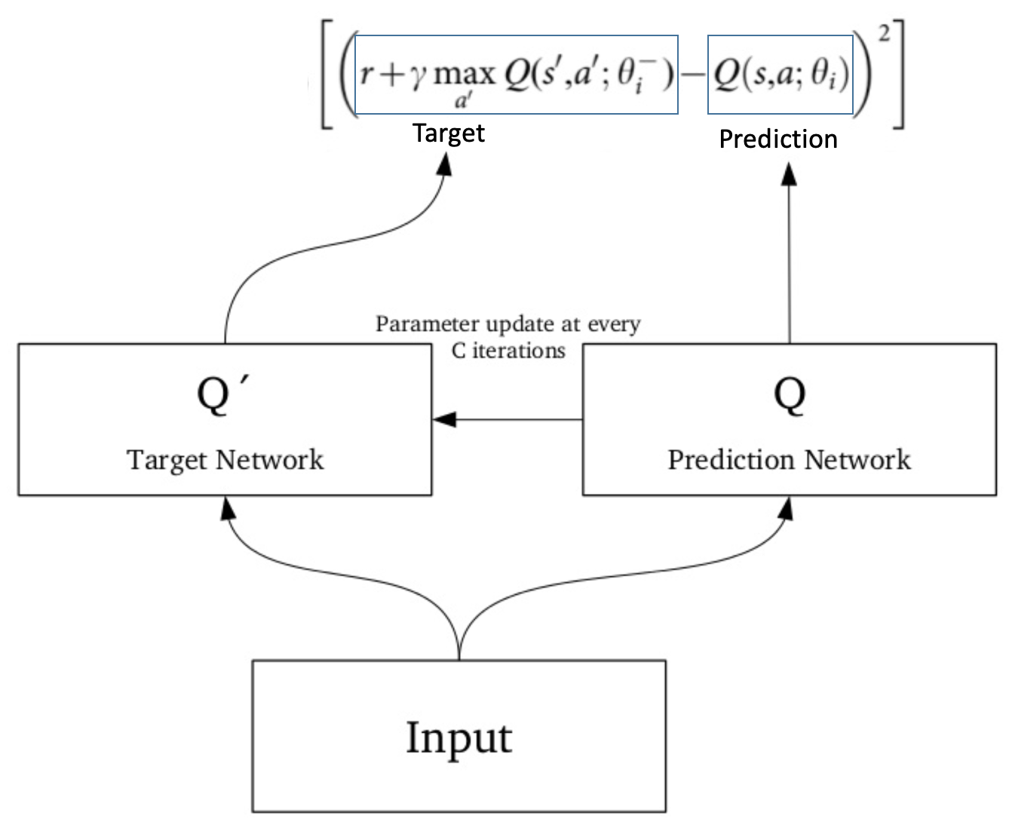
Deep Q-learning Network
Target Network
Why?
Non-Stationary or Unstable Target Values
One DNN that handles both lead to divergence
Instead Use A Target and A Prediction Network
Source: https://www.analyticsvidhya.com/
Notes:
there is a challenge when we compare deep RL to deep learning (DL) and this is the target values are non-stationary because at every iteration they are updated.
So it is hard to train a single dnn to calculate the predicted and the target value.
In contrast, we are using two networks, one to calculate the target and one to make predictions. The target network has the same architecture as the function approximator but with frozen parameters.
For every N iterations the parameters from the prediction network are copied to the target network which leads to a more stable training because it keeps the target function fixed for a while.

Slide 12
Deep Q-Learning
Experience Replay Memory
Prioritized Experience Replay
Stores experiences as tuples (s,a,r,s') in Replay Memory
Samples Mini-batches of past experiences
Uses Mini-batches to UPDATE weights on the prediction network
Why?
Experiences where the Agent diverges too much should matter most
Notes:
An important feature of the Deep Q-learning algorithm is the \textit{experience replay} method to train itself.
In \textit{experience replay} the agent stores in a replay memory tuples of $(s_{t}, a_{t}, r_{t}, s_{t+1})$. On every step, it samples a mini-batch of these from the replay memory and uses them to update the weights of the DQN that predicts the Q-value. This method helps us deal with correlations between similar states that result in the same action regularly, and thus, the agent will not lurch in training.
In addition, in Deep Q-learning we use prioritized experience replay because there would be experiences where the agent may diverge too much from the target value. In such a case, we want this experience to be more important than others and replay it to train the agent learn how to act in this case.
The next algorithm we use in our experiments is the A2C which relies on the Actor-Critic method, thus first I will present shortly the actor critic method and then move on to the A2C.

Slide 13
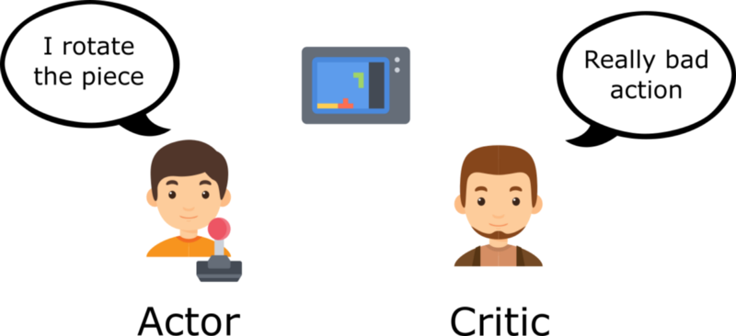
Actor-Critic method
Both Actor and Critic run in parallel
Two sets of weights
Notes:
Actor-Critic methods exploit the benefits of the policy-based and value-based algorithms by using two neural networks. One to quantify the value of the taken action (value-based) is called Critic and another to return the best action for the given state (policy-based) is called Actor.
Policy-based algorithms mean that we train the policy to find the best action from a specific state, whereas value-based algorithms learn to select actions according to the predicted state or action value.
To give an example, consider yourself playing a game with a friend. You are the actor, and your friend is the critic. At the beginning of the game, both of you have no experience with what is a good action or a good state. So you start by taking random actions, and your friend gives you feedback. As you play, both gain experience. Your friend will learn to evaluate your actions better, and you will use this information to make better decisions over which actions to take based on the given state.

Slide 14
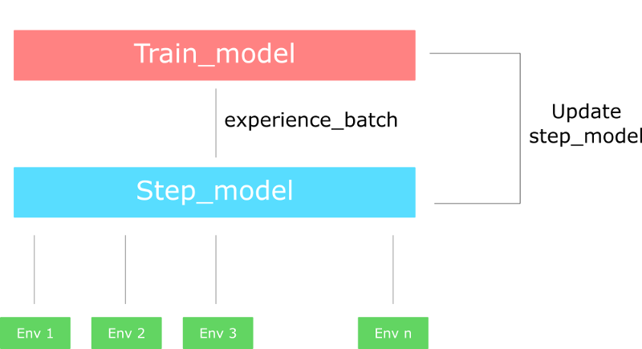
Advantage Actor- Critic Algorithm
Advantage Functions: Measure how better an action is compared to the others for a given state
Notes:
Advantage Actor-Critic (A2C) is a hybrid algorithm and relies on actor-critic methods.
Instead of having the critic to learn the Q values, we make him learn the Advantage values. That way the evaluation of an action is based not only on how good the action is, but also how much better it can be.
In fact, what we do, is to create multiple versions of the environment and just two networks.
The first network (usually referred to as step model) interacts with all the environments for n time steps in parallel and outputs a batch of experiences. With those experience, we train the second network (train model) and we update the step model with the new weights. And we repeat the process.
Advantage function captures how better an action is compared to the others at a given state, while as we know the value function captures how good it is to be at this state.

Slide 15
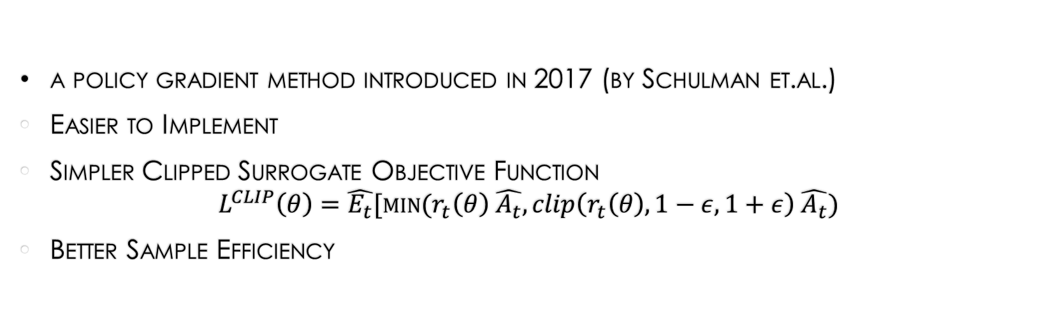
Proximal Policy Optimization
a policy gradient method introduced in 2017 (by Schulman et.al.)
Easier to Implement
Simpler Clipped Surrogate Objective Function $L^{CLIP}\left(θ\right)=\hat{E_{t}}[min⁡(r_{t}\left(θ\right) \hat{A_{t}}, clip\left(r_{t}\left(θ\right), 1−ε, 1+ε\right) \hat{A_{t}})$
Better Sample Efficiency
Notes:
Proximal Policy Optimization (PPO) is a policy gradient method introduced in 2017 \cite{schulman_proximal_2017}. As mentioned before, a policy is a function that maps states to actions or expected values. Policy gradient methods rely on optimizing parameterized policies concerning the expected return by gradient descent.
PPO, compared to Trust-Region Policy Optimization (TRPO), is easier to implement, has a simpler clipped surrogate objective function, and uses only a first-order optimization. Even though its simpler objective function, PPO has better sample efficiency in many control tasks than TRPO.
Moreover, PPO compared against several methods that considered to be efficient for continuous problems, outperformed them on almost every continuous control environment. In addition, it performed well in Arcade Learning Environments, including Atari games, against fine-tuned implementations of A2C and ACER.
As a policy gradient method, PPO tries to ensure that the updated policy does not converge too much from the old policy. This is done by clipping the update region to a small range of values.

Slide 16
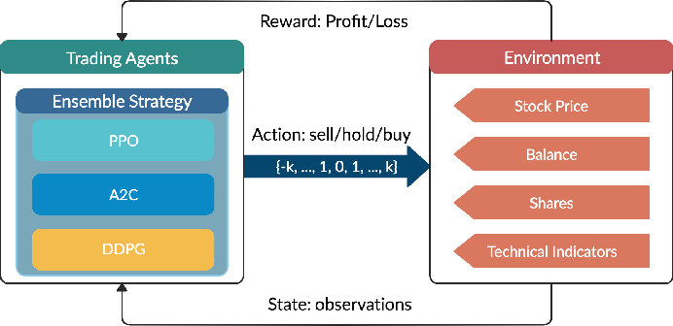
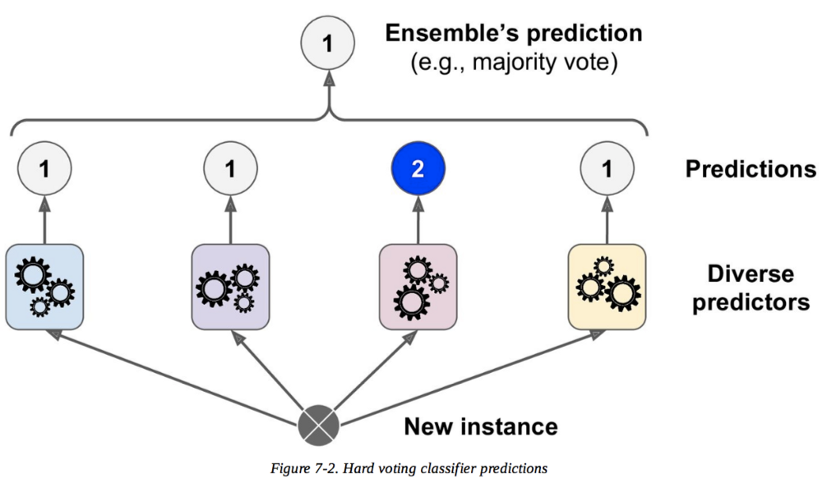
Ensemble Methods
Advantages:
Better Performance Compared to each contributor Algorithm
Faster Learning (in supervised learning)
Ensembles in RL:
Majority Voting
Rank Voting
Mixture Model
Boltzmann Multiplication
Boltzmann Addition
Notes:
Ensemble methods aim to enhance the model's final performance. In supervised learning, we use ensemble methods such as bagging, boosting, and stacking. These are leveraged to combine multiple preferably diverse classifiers using a voting scheme. On the other hand, in RL, ensemble methods represent and learn the value function. We use the learned policies from the agents to decide for the next action. Known ensemble methods in RL are Majority Voting, Rank Voting, Mixture Model, Boltzmann Multiplication, and Boltzmann Addition.
The top image depicts an ensemble method with drl algorithms for stock trading.

Slide 17
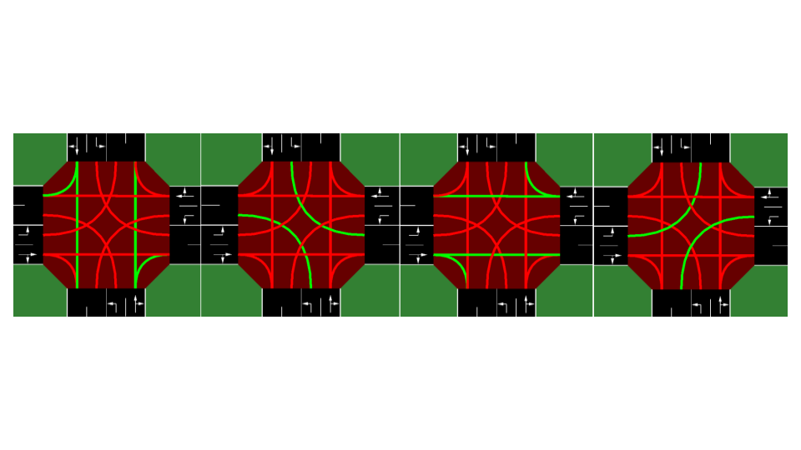
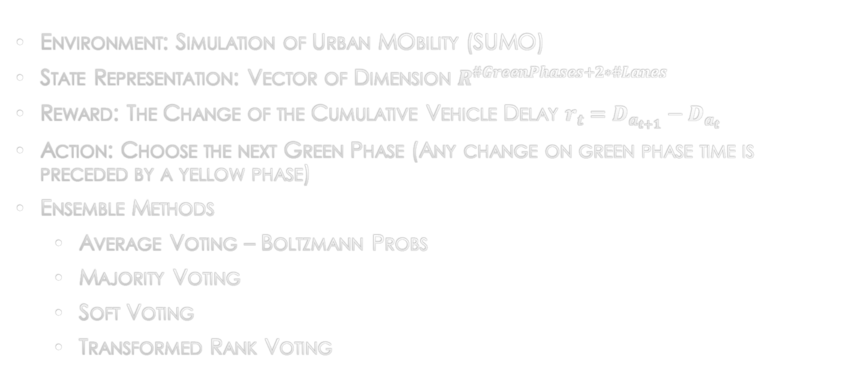
Our Approach - Methodology
Environment: Simulation of Urban MObility (SUMO)
State Representation: Vector of Dimension $R^{\#GreenPhases+2∗\#Lanes}$
Reward: The Change of the Cumulative Vehicle Delay $r_{t}=D_{a_{t+1}}−D_{a_{t}}$
Action: Choose the next Green Phase (Any change on green phase time is preceded by a yellow phase)
Ensemble Methods
Average Voting – Boltzmann Probs
Majority Voting
Soft Voting
Transformed Rank Voting
Notes:
With SUMO we can run simulations and compare the results of the application of DRL on traffic signal control in a gui.
The environment's state is a vector of dimension 20 in our case.
We have 4 discrete actions correspond to traffic movement as shown in the previous slide and We define as reward the change of the cumulative vehicle delay across the lanes. The agent’s goal is to maximize the cumulative rewards thus, selecting the reward to be negative the agent will minimize vehicle delays.
For the ensemble methods we used the average voting, majority voting, soft voting and a transformed rank voting.

Slide 18
Our Approach - Data
Single Intersection
2 Incoming – 2 Outgoing Approaches
Totally 8 Lanes
8 permitted Movement Signals
Synthetic data build on SUMO
Approach Length: 300m
Cycle Traffic Plan Duration: 82s
Notes:
The data we use are synthesized in SUMO.
We built a single intersection consists of 4 approaches with total length 300m. An approach is a road sector coming to the intersection. Each approach has two lanes. The permitted traffic movements are depicted with the green lines on the image. Thus we have left turns, move through with optional right turn to different directions. The phase intervals are:
Green Phase time: 33s
Yellow Phase time: 2s
Red Phase time: 6s
Total cycle traffic plan: 82s

Slide 19
Ensemble Methods – Average voting
Average Voting with Boltzmann Probabilities
Calculate action boltzmann probabilities
Stack
Average probability for every action
Choose the Next Action concerning The Averages
Notes:
In average voting we use action boltzmann probabilities. That means we transformed each agent's output action probabilities to boltzmann. Stack them together and then calculate the average for every action. Finally to decide the next action based on these values.

Slide 20
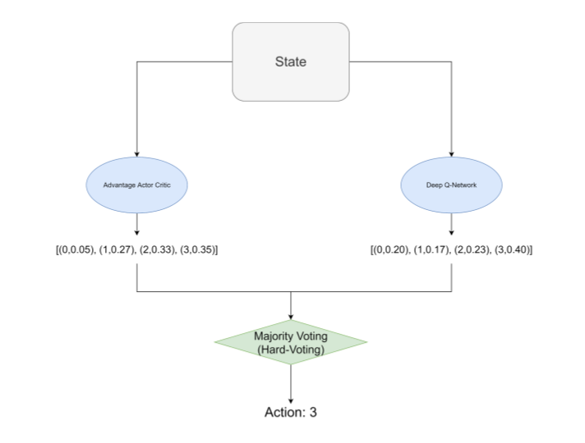
Ensemble Methods – Majority Voting
Majority Voting
Hybrid implementation
Next Action is the Most Voted Action Or
In case of Equal Voted Actions, we follow a Soft Voting approach
Notes:
Majority voting is a standard ensemble method used in supervised learning and, as mentioned before, in reinforcement learning. In supervised learning, the MV method comes in two ways the \textit{hard voting} and \textit{soft voting}. We implemented the MV method in a hybrid way because we use only two agents. To exploit the experience from the learned policies, we choose the most voted action across the agents (hard voting). But, when the agents predict different best actions we use the soft voting scheme to select one of them.
On the other hand, when we want to follow a less greedy strategy and explore the environment, we use action probabilities to randomly select an action from each agent and then to determine an action we follow the above approach.

Slide 21
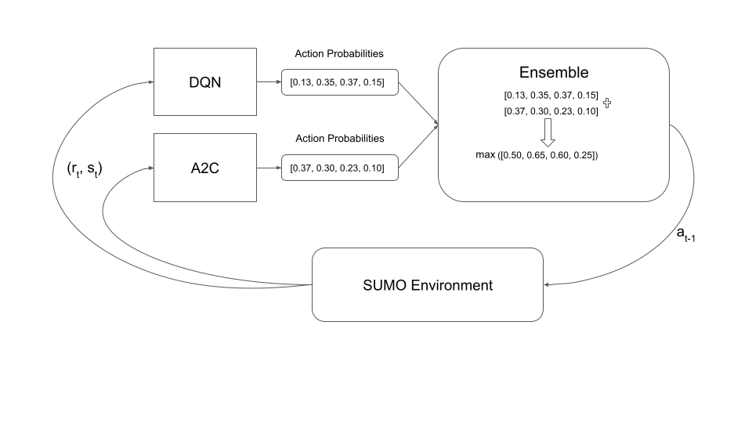
Ensemble methods – soft voting
Soft Voting
Agents Calculate action probabilities
Stack them
Summing probabilities for every action
Pick the action with the Highest value
Notes:
Soft voting is another type of majority voting but instead we sum up the action probabilities taken from every agent and then we choose the action with the maximum value. In this approach we promote exploration because as we see on the figure there are cases where the ensemble will predict an action that is a second best action for the agents.

Slide 22
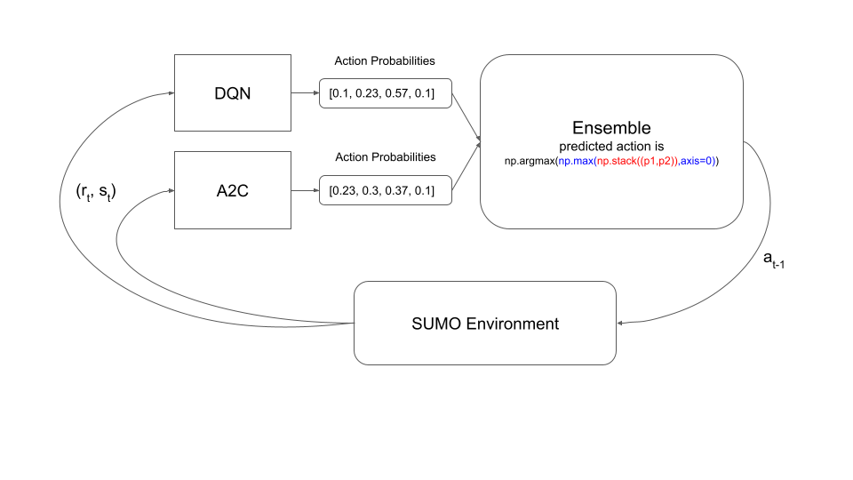
Ensemble methods - Transformed Rank voting
TRANSFORMED RANK VOTING
Get max probability for every action across agents
Multiply each probability with action's rank
Determine next action – the action with the maximum value
Notes:
Rank voting is an approach where we assign weights on the action concerning their rank. We used a transformed version of rank voting in which from the action probabilities we choose the maximum for every action across the agents. Then we multiply each action with its rank and decide the next action to be the action with the maximum value.

Slide 23
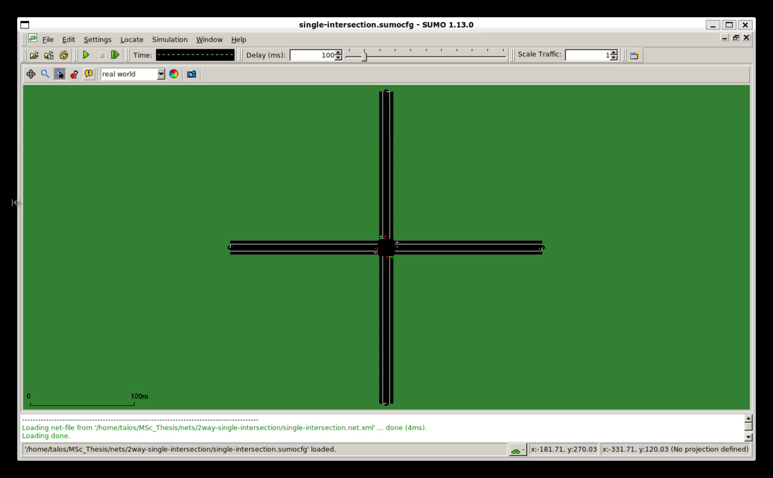
Simulation in sumo
Notes:
Before we move on to our results, I would like to demonstrate how a sumo simulation looks like. We will see the single intersection scenario on which we trained all the agents. In this simulation there is a fixed-time cycle traffic plan as mentioned before.

Slide 24
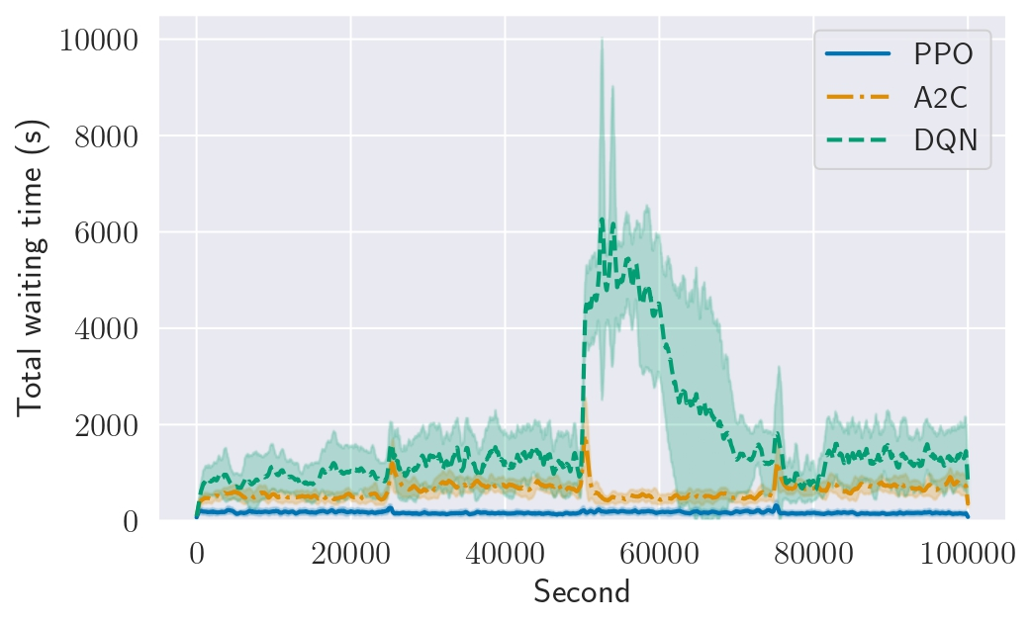
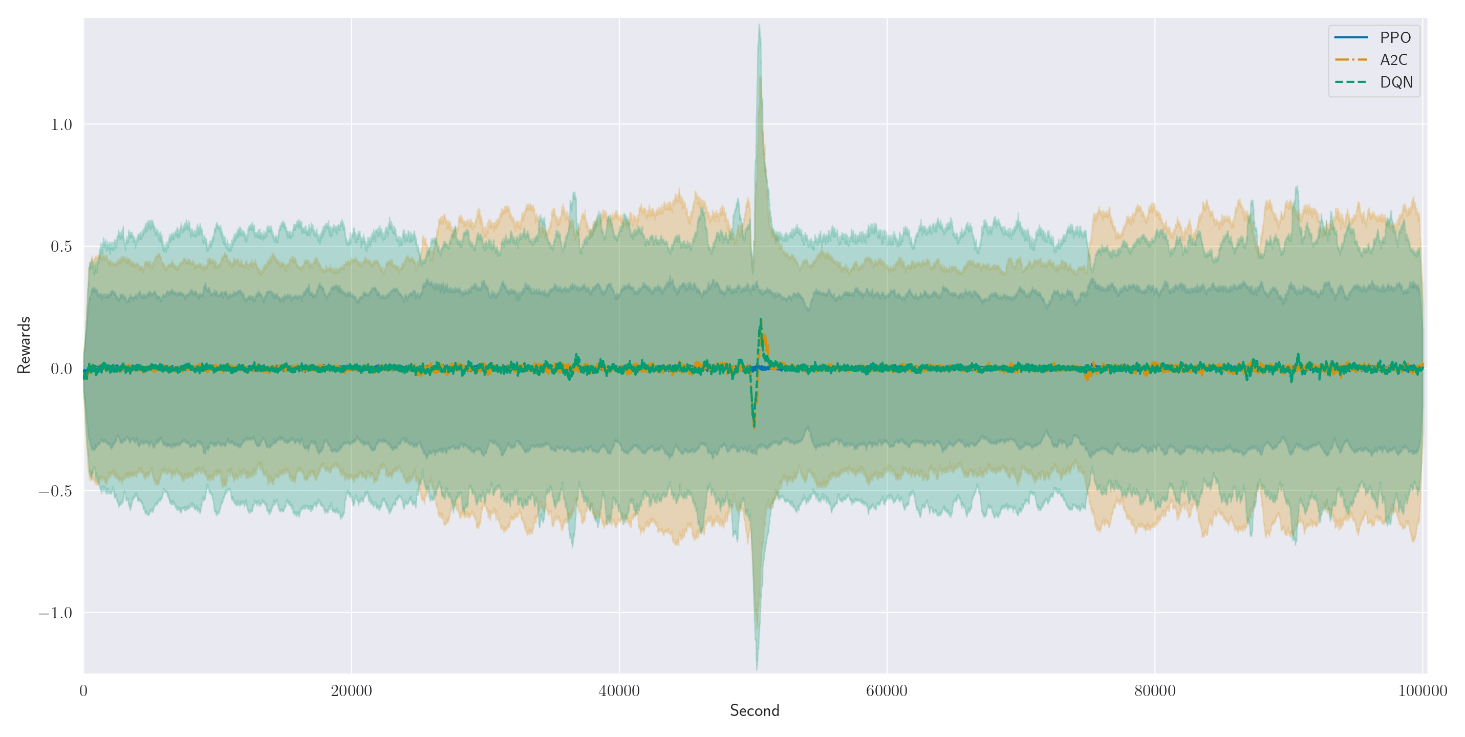
Experiments - results
Lower Waiting times are, of course, better
DQN makes decision over action that result in higher total delays
Agents aim to maximize their cumulative reward which is a negative number
All agents concerning rewards perform great
Notes:
At first we applied each algorithm on the single intersection.
All algorithms were trained for 1.5million time-steps. We evaluate each algorithm for 5 simulations and then take the average values of these.
To the right we see the average rewards for each agent. At every 25,000 seconds we change the direction of the traffic conditions. For example, from 0 to 25,000 seconds the traffic volume is larger in the N->S direction whereas from 25 – 50,000 seconds we see more traffic in the direction of W ->E.
All algorithms have maximized their rewards so we could say that all performed well.
But having a look on the left plot we see the total waiting time of all vehicles in the roadnetwork and The performance now is much different. PPO outperforms the other two. DQN fail to handle the traffic changes. And A2C has a rather good performance but not as good as PPO.
Running simulations for every algorithm we saw that A2C and DQN kept longer green phases corresponded to move-through traffic movements whereas PPO followed a more balanced strategy.

Slide 25
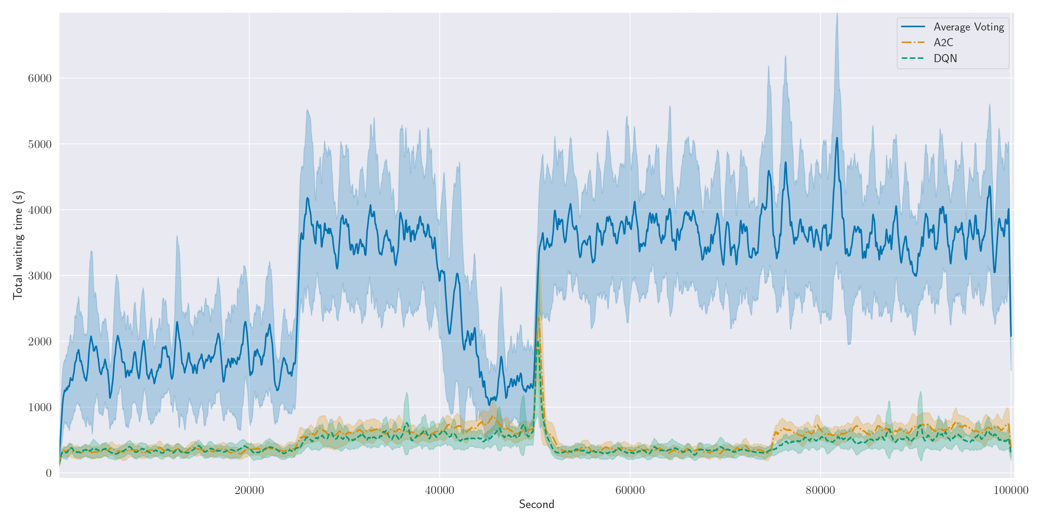
Experiments – Ensemble Results
Average Voting:
The ensemble method fails to choose the correct actions to minimize the total waiting time
Notes:
The following slides present the results from the ensemble methods.
Average voting didn't perform well in keeping low the total delay. Instead, it was worst than every other algorithm which definitely is not the goal of an ensemble method. At each traffic change the agent fails to adapt fast and thus we see very high values of delay.

Slide 26
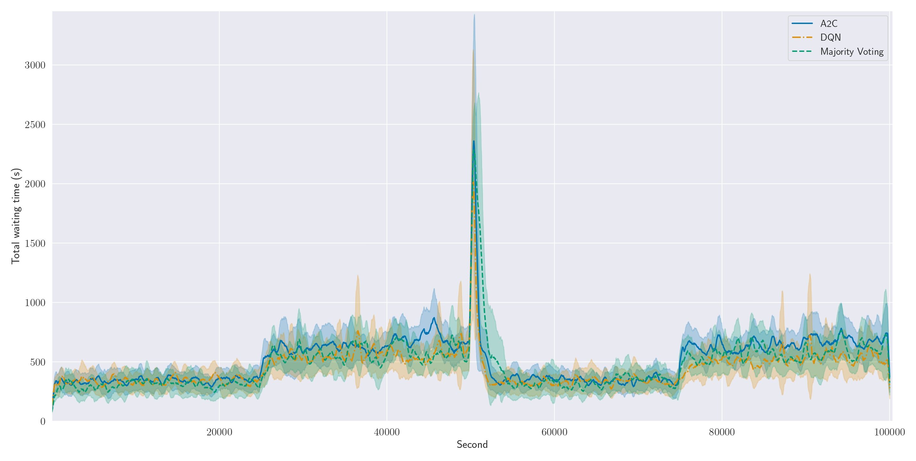
Experiments – Ensemble Results
Majority Voting:
The ensemble performs the same as its component algorithms
Notes:
Moving on, Majority voting the hybrid version I mentioned before performs almost the same as its components. A possible reason for this is because we used only two agents and for most of the time the agents seem to agree thus the ensemble actually takes the same decisions as its components.

Slide 27
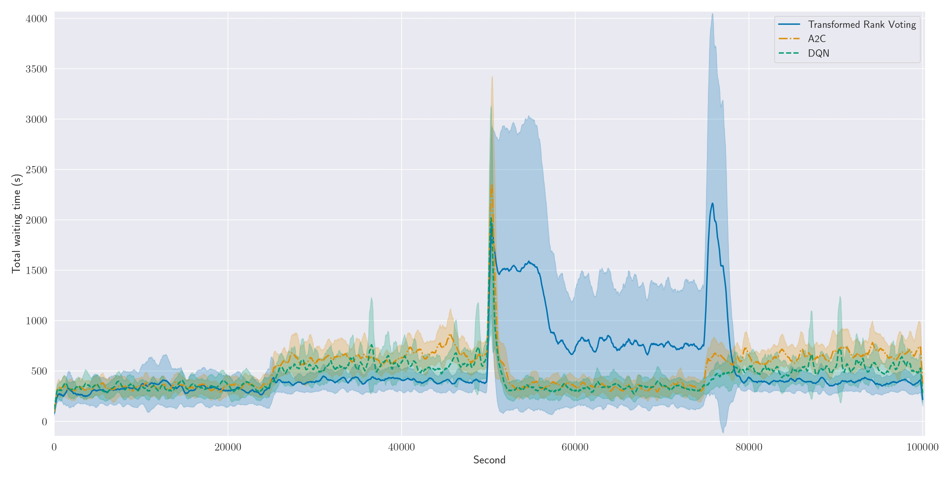
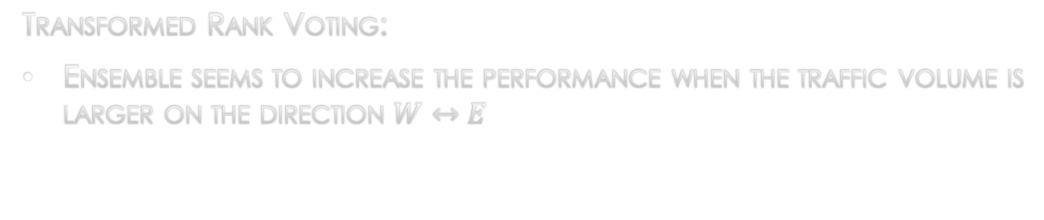
Experiments – Ensemble Results
Transformed Rank Voting:
Ensemble seems to increase the performance when the traffic volume is larger on the direction $W↔E$
Notes:
Transformed rank voting is better than average voting but still can not adapt well in some cases. We see a pick at around 50,000 seconds. At that time the system returns back to its initial conditions. But for most of the time the ensemble performs the same or better than its components.

Slide 28
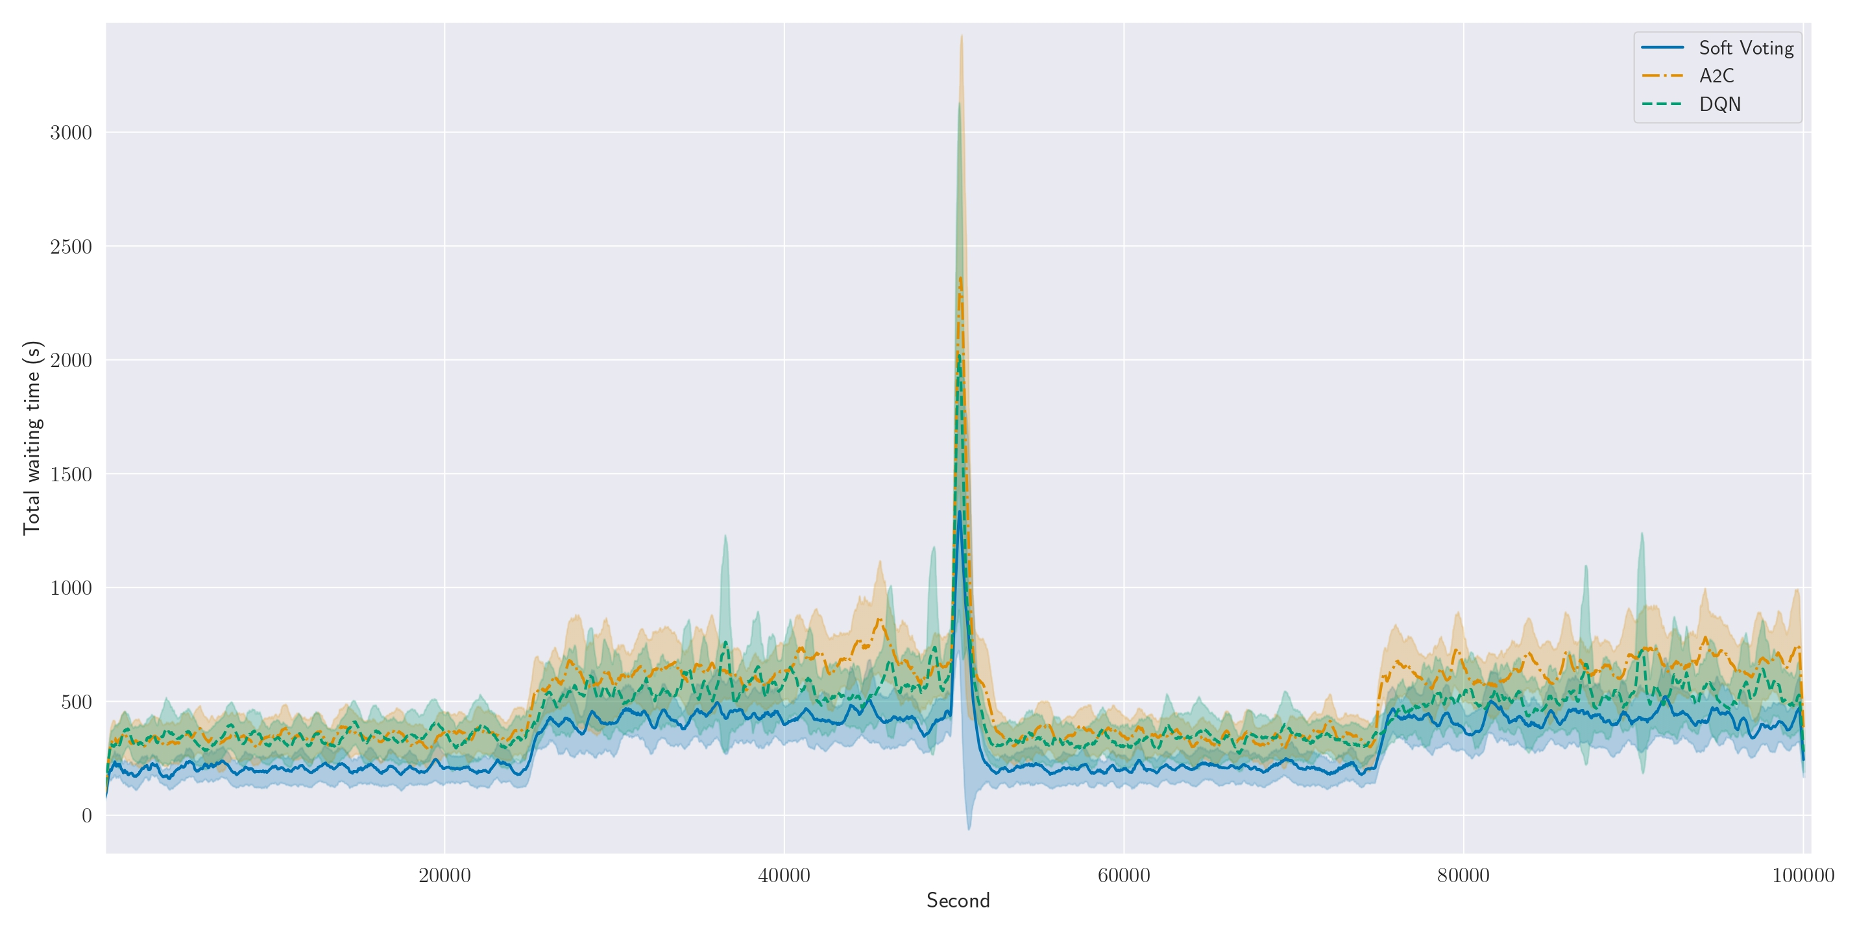
Experiments – Ensemble Results
Soft Voting:
Ensemble has better performance in the whole episode
Lower values on time delays
Notes:
And finally we ended our experiments with soft voting which seems to be the most promising approach because it has better performance than its composer algorithms and kept the time delays low enough.

Slide 29
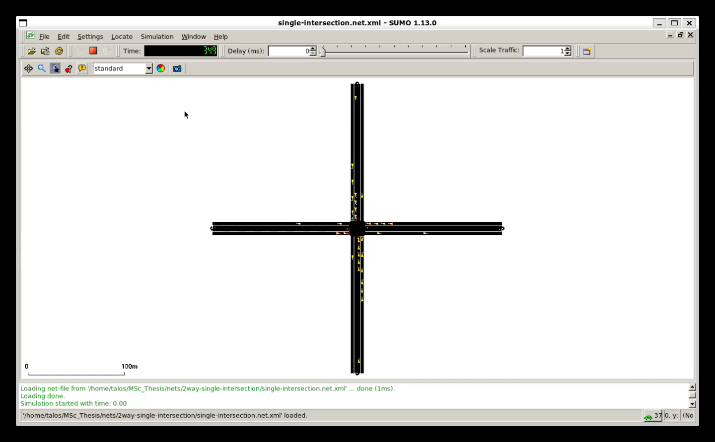
Soft voting in action

Slide 30
Conclusions
Soft Voting was the best ensemble method
Algorithms compose the ensemble must be:
Different on training policy methods (Value-based combined with Policy-based)
Weak concerning the total time delays
Notes:
In conclusion, the ensemble method following soft voting scheme increased algorithms performance and managed better the traffic signal.
Additionally, some conclusions came from the literature and other experiments that conducted but not included today is that for the ensemble to work better we need to use algorithms with different training policy methods and be as diverge as possible from each other. In this way we can exploit the advantages of every learned policy.

Slide 31
Future Work
Ensemble method consisting of more than two algorithms
Development of ensemble methods able to train its policy
Is this approach scalable?
Notes:
And finally, some plans for the future.
There is a lot of room for improvement on this work and to this direction one could try to build an ensemble with more algorithms.
Additonaly, It would be very interesting to see if this approach is scalable, how well could it perform on multiple intersections where we need to consider of multi-agent coordination. Moreover, for me it is also interesting the development of an ensemble method that we will be able to train its policy, learning which composer policy to choose given specific observations.

